Slide 1
G D 2 1 0
Game Studio - Prof. Alec McClure

Slide 2
Last week...

Slide 3
A designer needs to be good at turning anything into a game

Slide 4
Much of a designer’s early career will be dealing with IP

Slide 5
You can make a game
about anything

Slide 6
LAST WEEK’s HOMEWORK
PLAY Increpare’s Slave of God seizure warning!!
READ Art Games chapter from Works of Game (Sharp)
READ Rock Paper Shotgun - Photorealism is Crucial
READ Video Games Can Never be Art (Roger Ebert)
WRITE
What is your reaction to Slave of God?
Can games be art?
Do pretty graphics matter?
Should games be realistic?
etc.

Slide 7
Warm seat discussions!
wait, what?

Slide 8
Half the class moves to the next seat every 2 minutes!

Slide 9
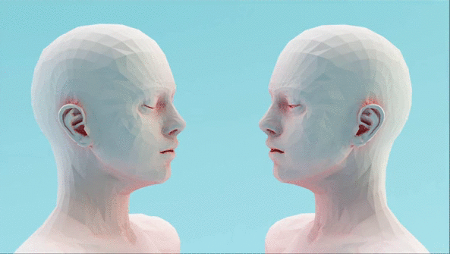
GAMES AS AN
EXPRESSIVE
MEDIUM

Slide 10
STYLE is IMPORTANT

Slide 11
STYLE is SUBSTANTIVE

Slide 12
REALISM can be more than just PHOTOREALISM

Slide 13
Essentialize experience
how can you find the right metaphors?
Notes:
truth of the subjective experience

Slide 14
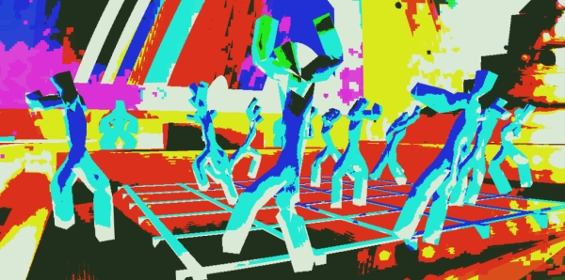
Notes:
NOT PLAY BECAUSE GOOD, but successful
evocative,
inspires feelings
no textures … not photorealistic

Slide 15

Wtf happened last night?
All I remember...
vivid colors, deep house beats, everything spinning, human connection… what was their name again?

Slide 16
COMMUNICATING EMOTION

Slide 17
Establishing a unique experience
and forgetting that you’re playing a game

Slide 18
GAME
FEEL

Slide 19
Game feel as the experiential sensation of a game

Slide 20

Game Feel
What does Tekken feel like?
Pac-man?
Katamari Damacy?
book link

Slide 21
“The five most common experiences of game feel are:
● The aesthetic sensation of control
● The pleasure of learning, practicing and mastering a skill
● Extension of the senses
● Extension of identity
● Interaction with a unique physical reality within the game”

Slide 22
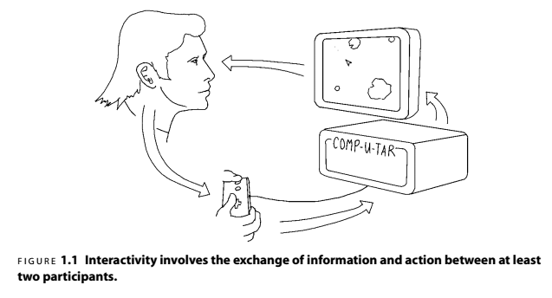
Notes:
simple feedback loop

Slide 23
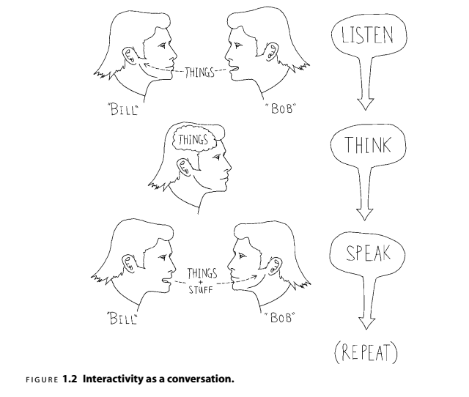
Notes:
The conversation in Figure 1.2begins when one participant, Bob, speaks. The
other participant, Bill, listens to what was said, thinks about it, formulates a response
and speaks in return. Now it’s Bob’s turn to listen, think and speak, and so on. In
Crawford’s model, a computer replaces one of the participants, “ listening ”to the
player’s input via the input device, thinking by processing that input and changing
system state and “ speaking ”via the screen and speakers ( Figure 1.3 ).

Slide 24
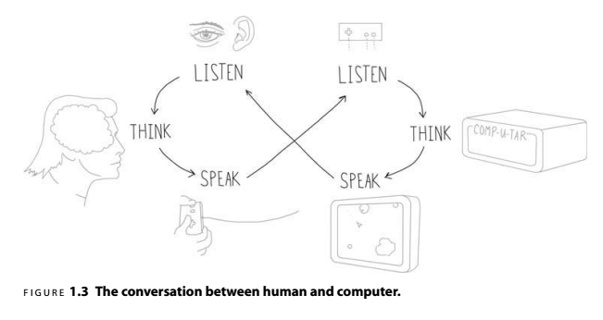
Notes:
quickest way to break a game, unintuitive controls

Slide 25
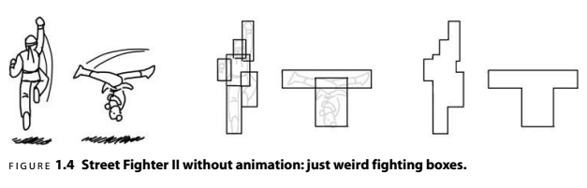

Slide 26
Control Interface Evolution
evolving the illusion

Slide 27


Slide 28



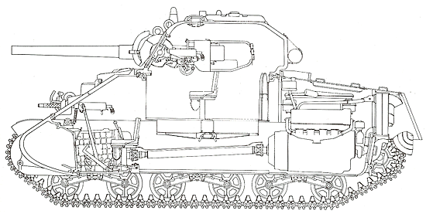
vs
vs
vs
vs

Slide 29

you are the car
“that @#$% hit me!”

Slide 30

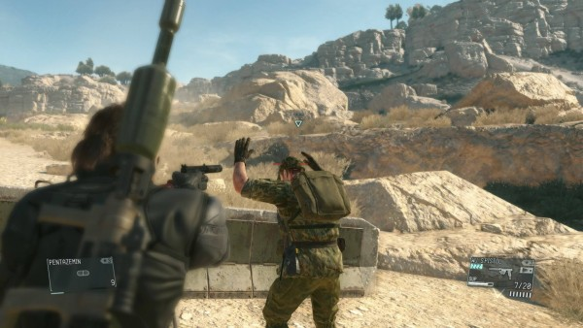
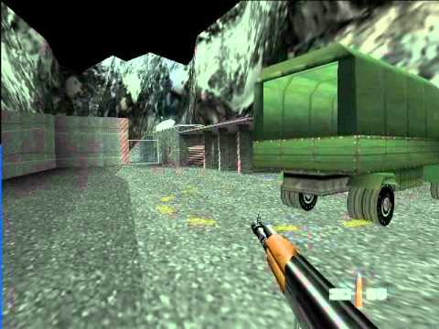
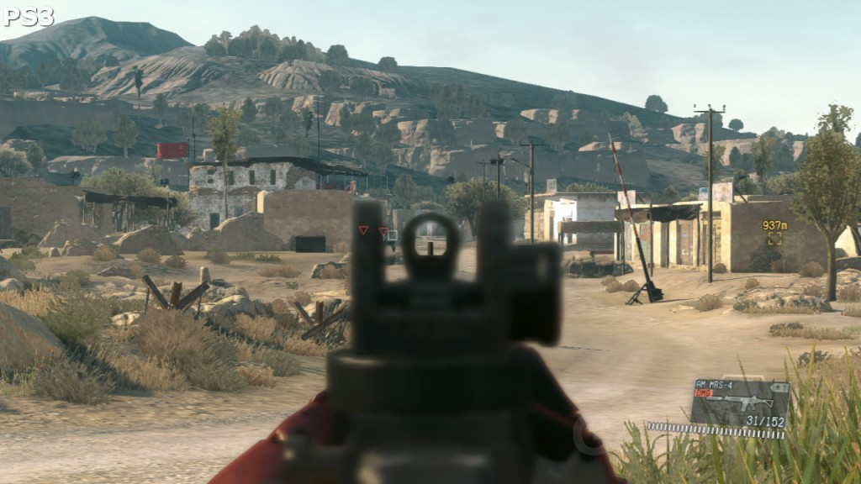
vs

Slide 31
fluid, harmonious
and natural

Slide 32


Make your games juicy!
subtle details make all the difference

Slide 33
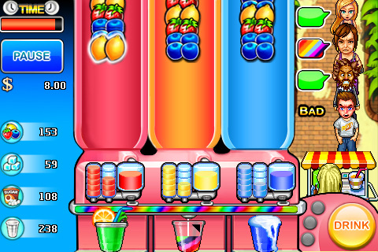

Slide 35
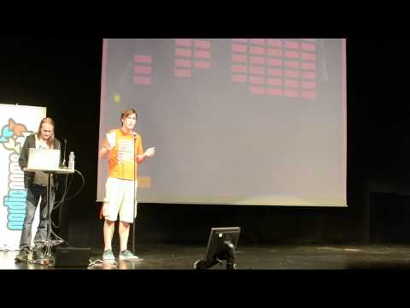

Slide 36
Game
Engines
Notes:
17 years ago!!

Slide 37
UNREAL
ENGINE 4 (2012)
Notes:
unreal script is gone

Slide 38
“The big goal with the Unreal technology all along was to build up a base of code that could be extended and improved through many generations of games. Meeting that goal required keeping the technology quite general-purpose, writing clean code, and designing the engine to be very extensible. The early plans to design an extensible multi-generational engine happened to give us a great advantage in licensing the technology as it reached completion. After we did a couple of licensing deals, we realised it was a legitimate business. Since then, it has become a major component of our strategy.”
-- Tim Sweeney in an interview with Maximum PC

Slide 39
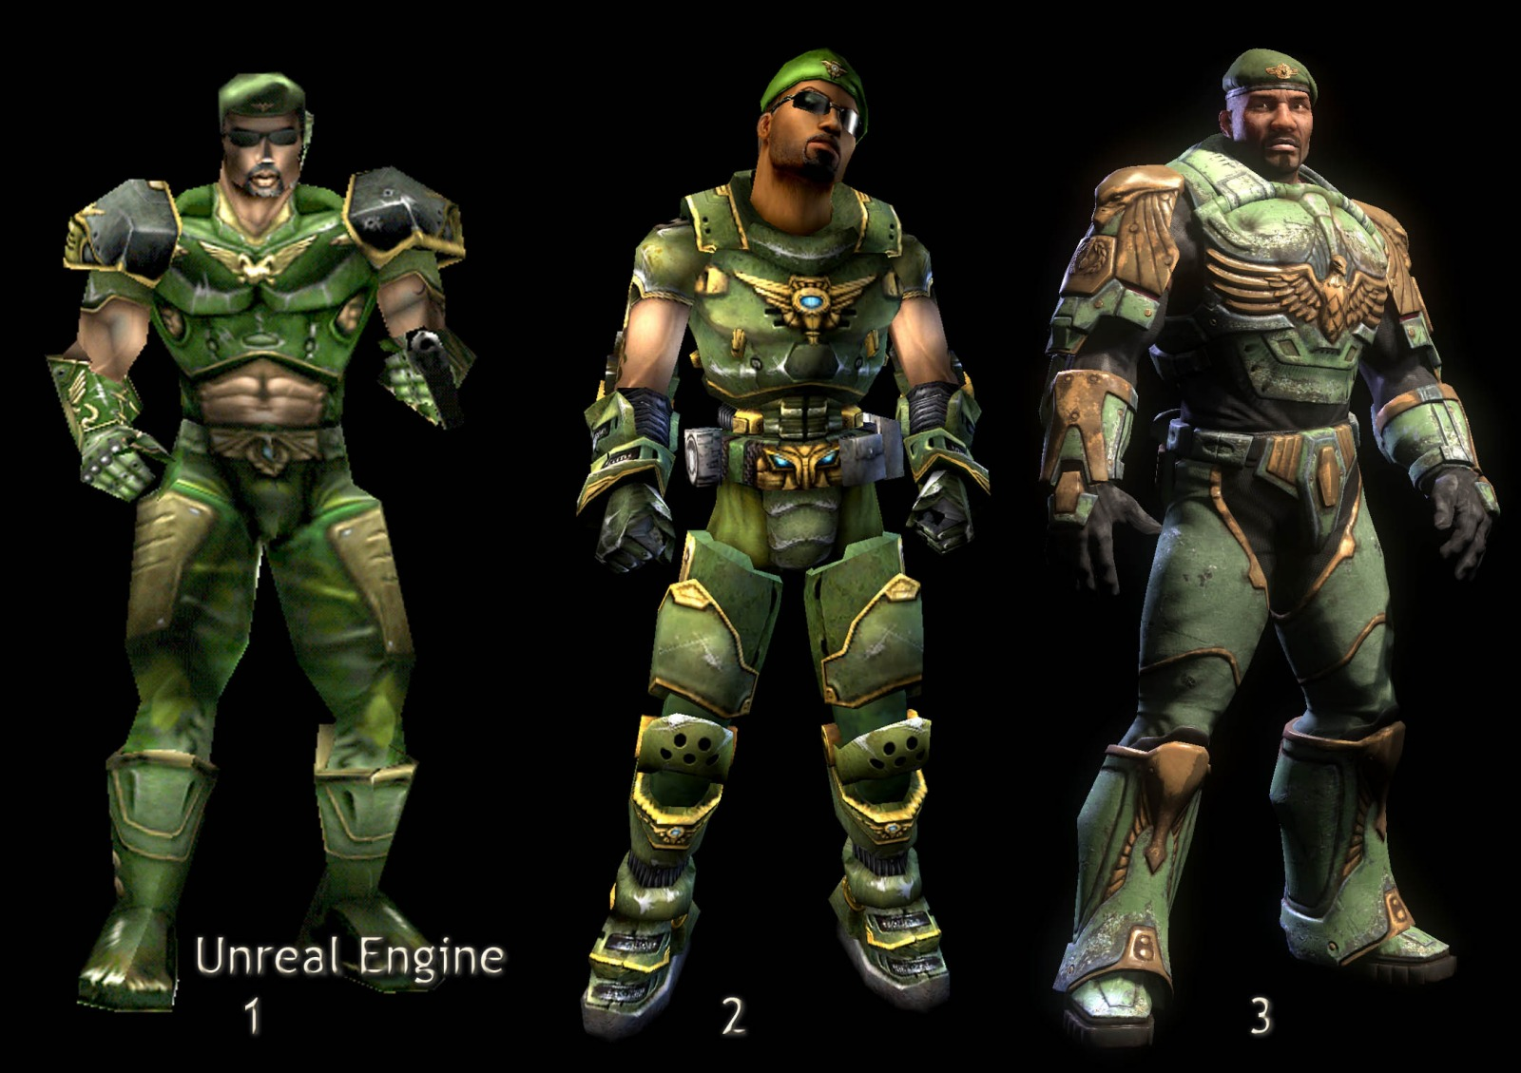

Slide 40


Slide 41
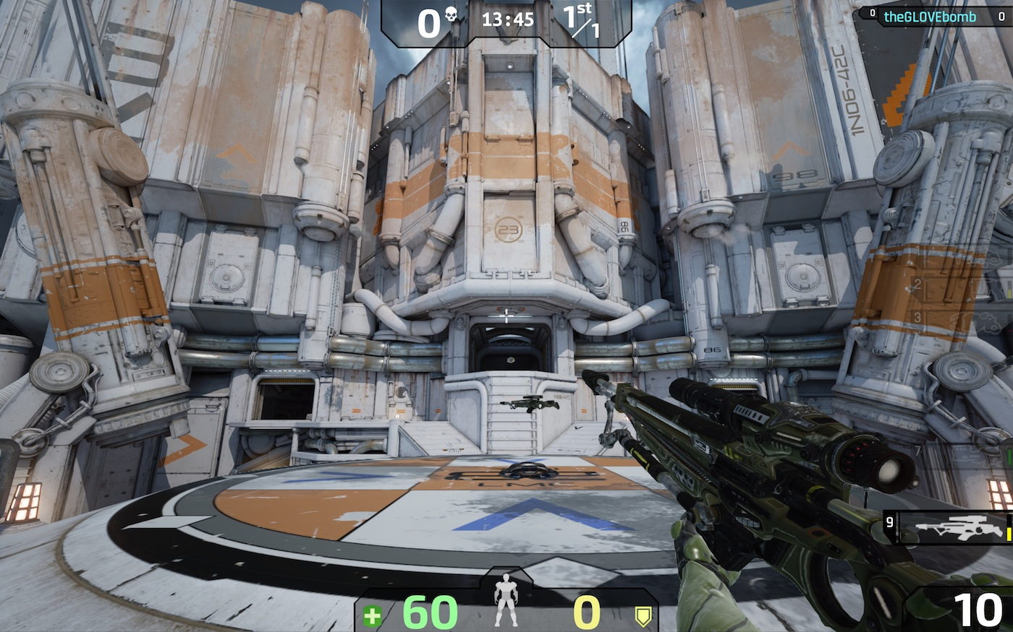

Slide 42
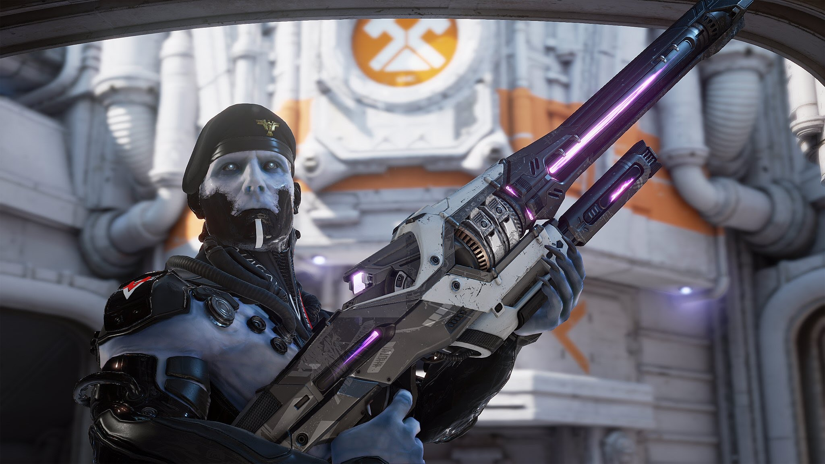

Slide 43
Photorealistic (link)

Slide 44
Released as subscription model in 2014
$19/month + 5%

Slide 45
Free to use, with access to source code; 5% royalty after first $3000USD per quarter

Slide 46
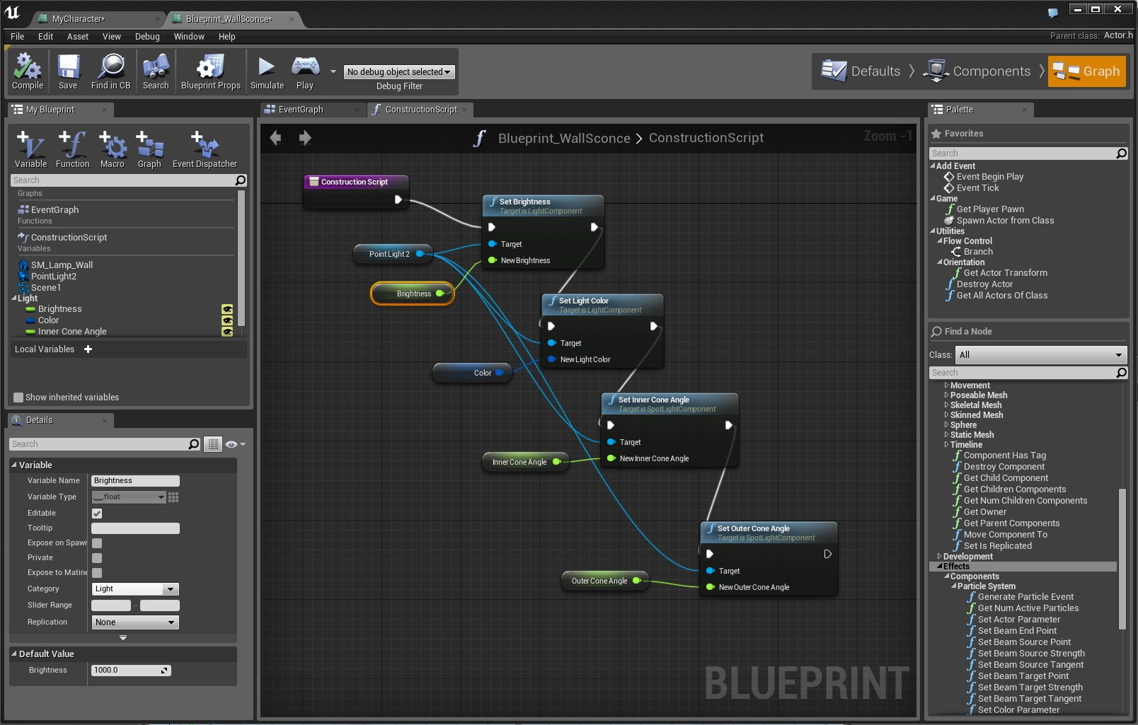
Notes:
blueprints

Slide 47
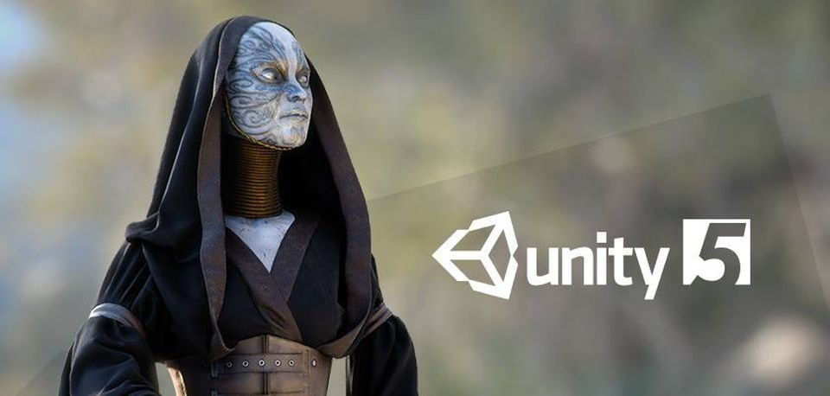

Slide 48
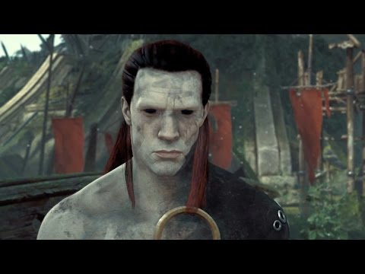
Unity
C# Scripting
Popular with indie devs
Similar interface to UE

Slide 49
“Unity Pro is available for a fee and Unity Personal has no fee; it is available for any use to individuals or companies with less than US$100,000 of annual gross revenue.[6][7] On March 3, 2015 with the release of Unity 5.0, Unity Technologies made the complete engine available for free including all features, less source code and premium support. Unity is noted for an ability to target games to multiple platforms.”

Slide 50
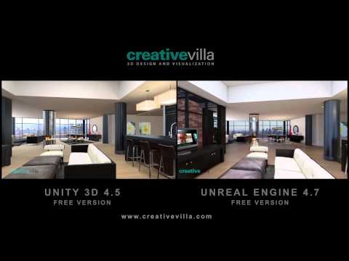
Unity vs. Unreal

Slide 51


Slide 52
Game Maker Studio
+Accessible drag and drop scripting (compiles to GML)
-Up-to-date version is Windows only (Game Maker Studio)

Slide 53


Slide 54
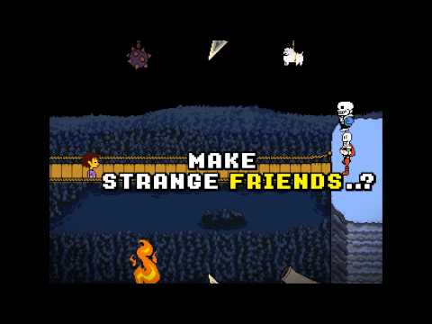

Slide 55
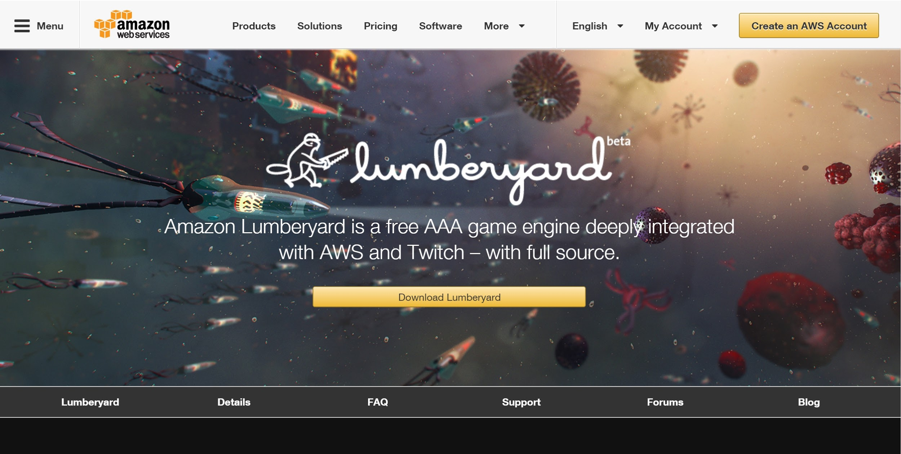
Lumberyard
Notes:
based on cryengine

Slide 56
Game Design
Profile Presentation
due Week 5, 2018.03.06

Slide 57
For this project students will be required to create a formal presentation that focuses on one important game design. The presentation should focus on profiling the design of the game. Students will be required to read at least two interviews with the designer/developer and provide at least 4 other reputable references for their presentation.
Worth 30 points of final grade

Slide 58
NOT a review NOT a synopsis
We (generally) do NOT care about the story.

Slide 59
Things to discuss...
Tell us about the designs, desires, what elements are original, unoriginal, what works and doesn't work.
Profile the game's designer and how does their work relate to this game (if applicable).
What kind of constraints are placed upon the player? How do they contribute to gameplay?
What went into programming this game? Walk us through the code logic for some of the core mechanics of the game.

Slide 60
Use the MDA framework to present your analysis of the game.
Addl reading:
http://gangles.ca/2009/08/21/mda/
https://gamedesignconcepts.wordpress.com/2009/07/13/level-5-mechanics-and-dynamics/
https://www.gamasutra.com/blogs/TuckerAbbott/20101212/88611/MDA_Framework_Unconnected_Connectivity.php

Slide 61
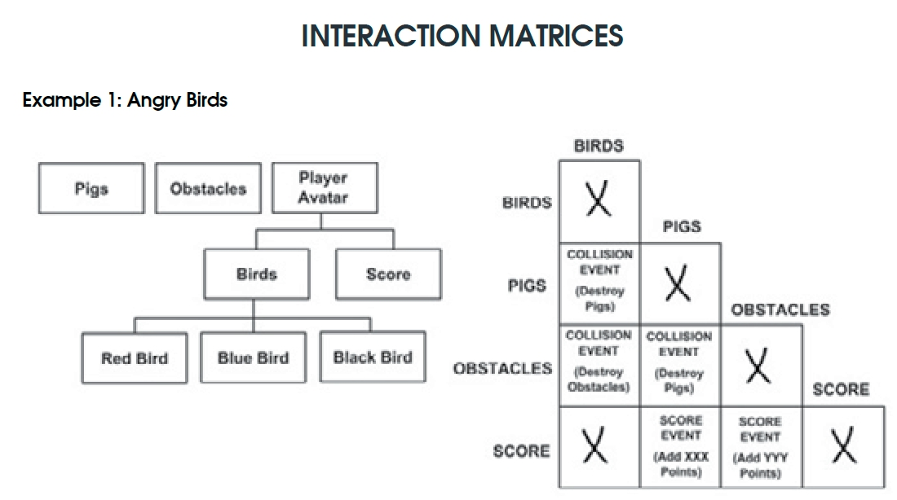

Slide 62
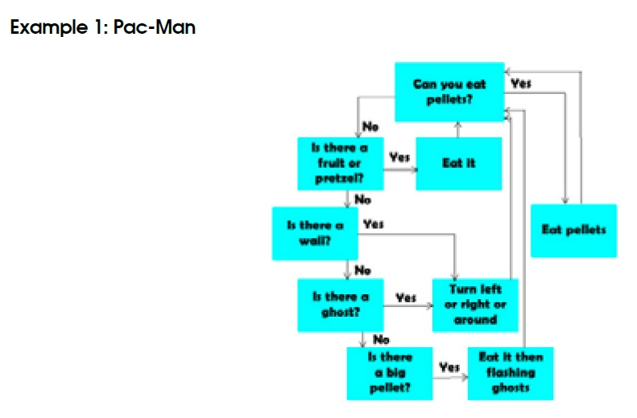
Game Flow Diagrams

Slide 63
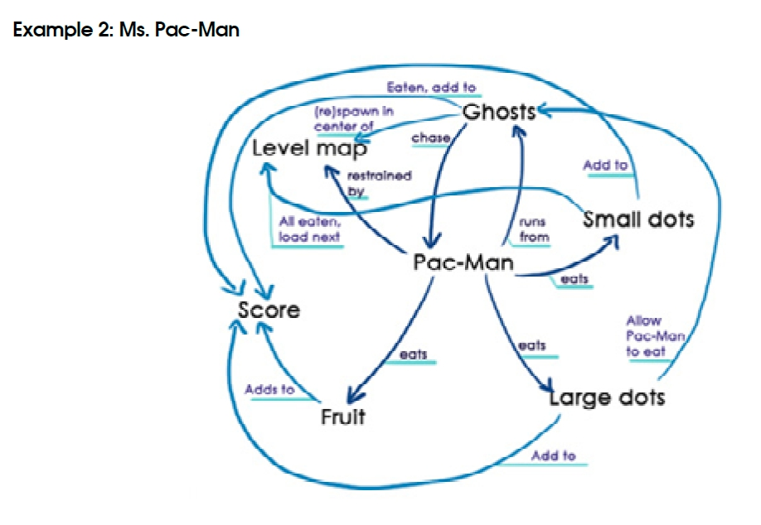

Slide 64
Eligible Titles
Super Meat Boy TowerFall Ascension Hyper Light Drifter The Talos Principle Pony Island Antichamber This War of Mine Nidhogg Tricky Towers Move or Die Party Hard Papers, Please McPixel Limbo FTL Hotline Miami Duck Game Papo & Yo The Stanley Parable Undertale VVVVVV Circa Infinity
Dream Daddy Little Girl in Underland Typing of the Dead:Overkill Depression Quest Cave! Cave! Deus Videt Lume CAVE! CAVE! DEUS VIDET. Jenny Jiao Hsia (q_dork) What If Platformers Were RPGs Increpare Flow Flower Inside
Awkward Date Ultimate Chicken Horse Rocket League Speedrunners Screencheat Fez Luftrausers Starseed Pilgrim Cookie Clicker The Graveyard Porpentine Monument Valley Kerbal Space Program Flappy Bird Inside Prison Architect Dwarf Fortress Dys4ia Gone Home Who's Your Daddy? Redshirt

Slide 65
HOMEWORK
Read
Game Design Workshop, Read at least 5 “Designer Perspectives”
RR3
One to two page response to reading (400 word minimum). This should be in reaction to the reading, not a summary.

Slide 66
LAST WEEK’S HOMEWORK
Read
Game Design Workshop, Fullerton - Chapter 15 (“Understanding the Game Industry”)
RR2
One to two page response to reading and lecture.

